Slide 1
Applied Data Science Capstone
A Study of COVID-19

Slide 2

introduction
Coronavirus disease 2019 (COVID-19) is an infectious disease caused by the severe acute respiratory syndrome coronavirus (SARS-CoV-2) that outbroke in December 2019.
As of April 27th, 2020
> 3 million around the world were infected
> 1 million Americans were infected
It is important for the public to understand what factors are related to the number of COVID-19 cases, so that effective measures can be taken to reduce the risk of exposure to coronavirus.
Factors that are explored in this project;
Population
Population density
Venue types in the neighborhood

Slide 3
DATA ACQUISITION
Data Sources:
Wikipedia: https://en.wikipedia.org/wiki/List_of_counties_in_New_York
New York State government website: https://health.data.ny.gov/browse?tags=covid-19
NYC Department of Health and Mental Hygiene GitHub: https://github.com/nychealth/coronavirus-data
GitHub open sources
Foursquare API
Methods:
BeautifulSoup
Requests.get

Slide 4
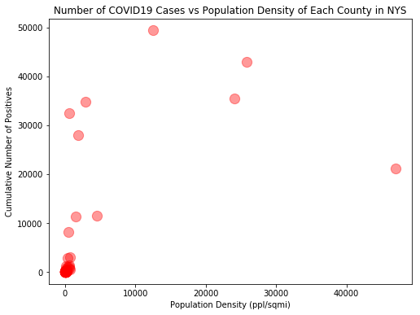
Data exploration
A positive relationship can be observed between the total number of positive COVID-19 cases and the population density of each county.
However, data shows weak linearity overall.
Strong negative relationship
Strong positive linear relationship
Figure 1. Number of COVID-19 Cases vs Population Density of Each County in NYS

Slide 5
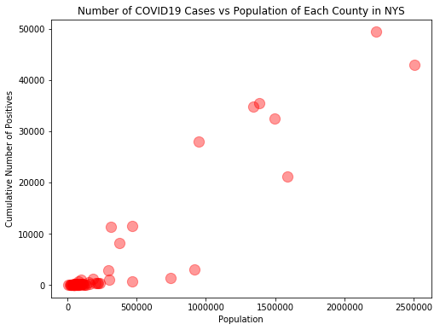
Data exploration
A positive relationship can be observed between the total number of positive COVID-19 cases and the total population of each county.
Data shows relatively strong linearity.
Figure 2. Number of COVID-19 Cases vs Population of Each County in NYS

Slide 6
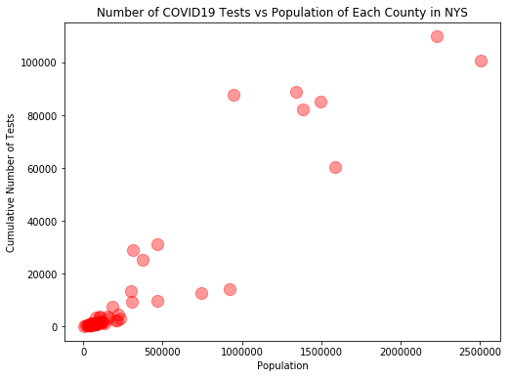
Data exploration
Similar to the previous plot, a positive relationship can be observed between the total number of positive COVID-19 cases and the total population of each county.
Data shows relatively strong linearity.
Figure 3. Number of COVID-19 Tests vs Population of Each County in NYS

Slide 7
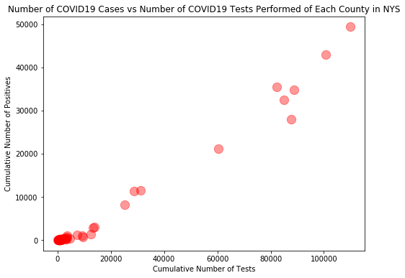
Data exploration
Data shows strong positive linear relationship.
Figure 3. Number of COVID-19 Tests vs Population of Each County in NYS

Slide 8
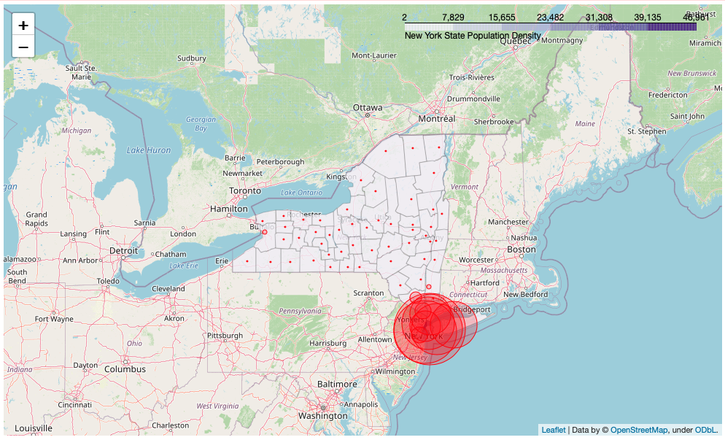
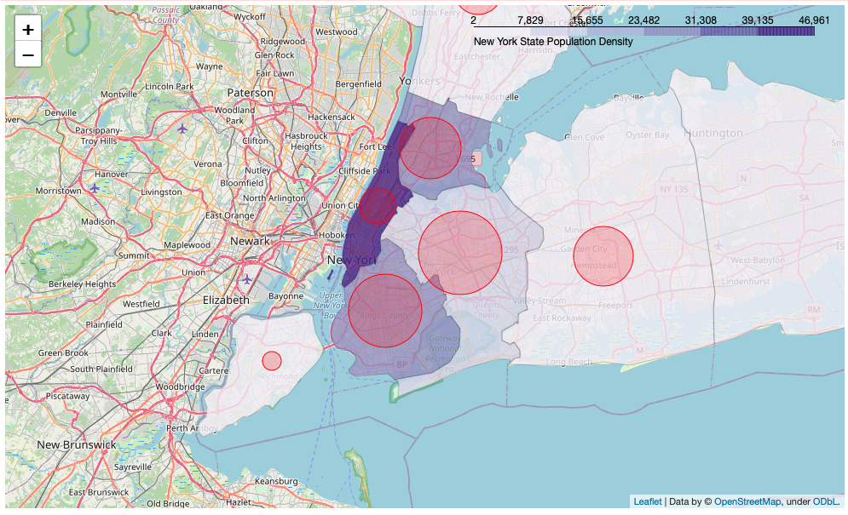
COVID-19 Case Mapping
Bronx
Manhattan
Queens
Staten Island
Brooklyn
Figure 5. COVID-19 Case Mapping (New York State)
Figure 6. COVID-19 Case Mapping (New York City)
The majority of the COVID-19 cases in New York State is in or close to New York City.
Queens, Kings (Brooklyn) and Bronx have highest numbers of COVID-19 cases in New York.
New York county (Manhattan), which has the highest population density in New York, surprisingly has a significantly lower number of COVID-19 cases comparing to the proximal counties.

Slide 9
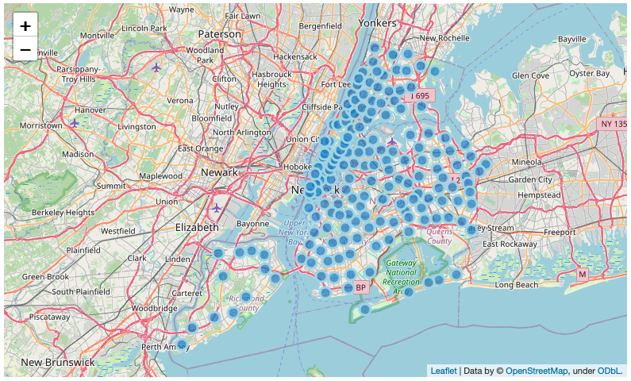
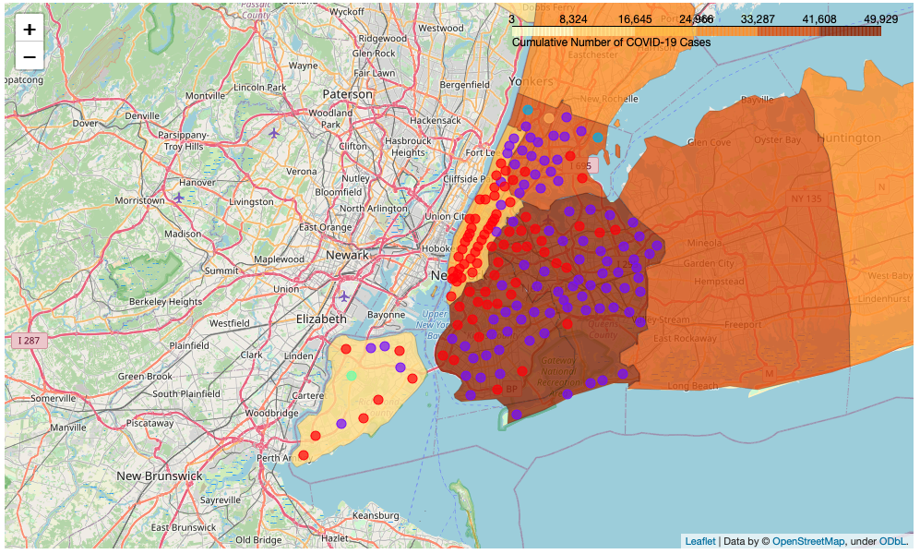
New York City Neighborhood Clustering
4
2
Bronx
Manhattan
0
1
Queens
Staten Island
3
Brooklyn
Figure 7. Locations of Zip Codes in New York City
Figure 5. Venue Clusters and COVID-19 Case Distribution
Cluster 0: most frequent venues are coffee shops, bakeries and bars. Dominating in areas with less COVID-19 cases
Cluster 1: most frequent venues are restaurants, supermarkets and bus stations. Dominating in areas with more COVID-19 cases

Slide 10
discussion
Number of COVID-19 cases and number of COVID-19 tests have a strong positive linear relationship, suggesting the importance of getting enough COVID-19 tests.
The relationship between number of COVID-19 cases and population density is displays a weak linearity. In counties with high population density, the number of COVID-19 cases is even inversely proportional to population density. This is possibly due to the strict stay at home order.
Areas with restaurants, supermarkets and bus stations dominating have more COVID-19 cases (Bronx, Brooklyn and Queens).
Large flows of people
People staying in confined spaces for a relatively long time
Areas with coffee shops, bakeries and bars dominating have significantly smaller number of COVID-19 cases (Manhattan and Staten Island).
Short stay and less frequent visits

Slide 11
Conclusion
To avoid the spread of coronavirus:
Increase number of testing.
Avoid dining in restaurants and shopping in supermarkets in person.
Stay at home as much as you can.

